Slide 1

SecureGate: Automated Unregistered Vehicle
Flagging Using License Plate Detection
Guided By- Prof. Vikas Gupta
Dept. Of Electronics Engg.
By- Krushna Raut(37), Sankalp Choubey(49), Vikram Jaiswal(53)

Slide 2

CONTENTS
01. Problem Statement
02. Dataset Overview
03. Methodology
04. Experiments & Hyperparameters
05.Results
06.Challenges & Learnings
07. Conclusion & Future Work

Slide 3
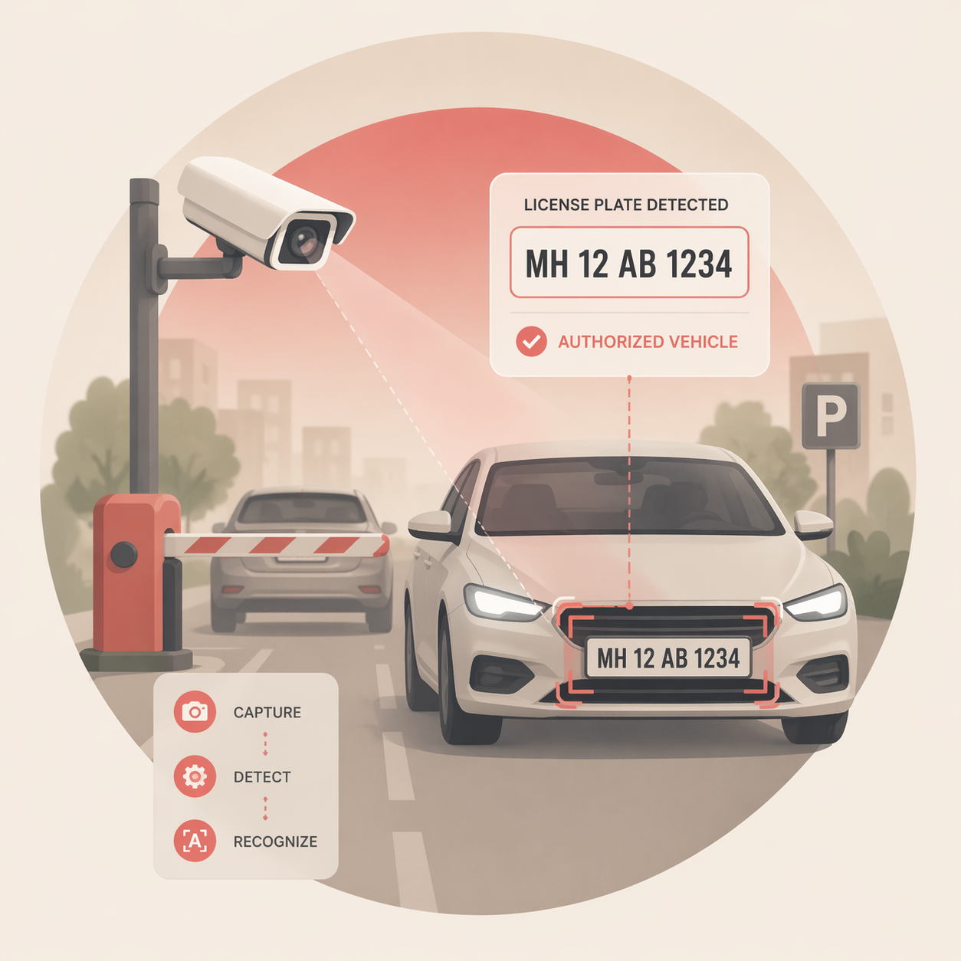
Problem Statement
Problem Objectives
Manual vehicle verification is inefficient, slow, and error-prone. Unregistered vehicles pose security risks, revenue loss, and enforcement challenges in parking areas, campuses, and toll systems.
Detect license plates from vehicle images using YOLOv8
Extract plate numbers using multi-engine OCR (Kimi Vision, EasyOCR, Tesseract)
Validate and clean extracted text to match Indian plate format
Compare with registered vehicle database (SQLite)
Flag unregistered vehicles via web dashboard with alerts

Slide 4
Dataset Overview
Dataset Name: Indian vehicle license plate dataset (2022)
Source: Kaggle
Attribute | Descripition
Height | Image height (pixels)
Width | Image width (pixels)
Format | Image format (JPEG/PNG)
Mode | Color mode (RGB/RGBA)
Size_bytes | File size in bytes
Links to resources

Slide 5
Methodology
Phase 1
Plate Detection (YOLOv8)
Phase 3
OCR & Validation
Phase 5
Image Acquisition
Phase 2
Preprocessing Pipeline
Phase 4
Database & Output

Slide 6
Experiments
Hyperparameters
• Epochs: 50 (or your actual value)
• Image Size: 640 × 640
• Batch Size: 16
• Optimizer: AdamW
• Learning Rate: 0.001
• LR Scheduler: Cosine Decay
• Model: YOLOv8 (custom trained)
• Dataset: Indian License Plate Dataset (Kaggle)
• Task: License Plate Detection
• Train/Test Split: 80% / 20%

Slide 7
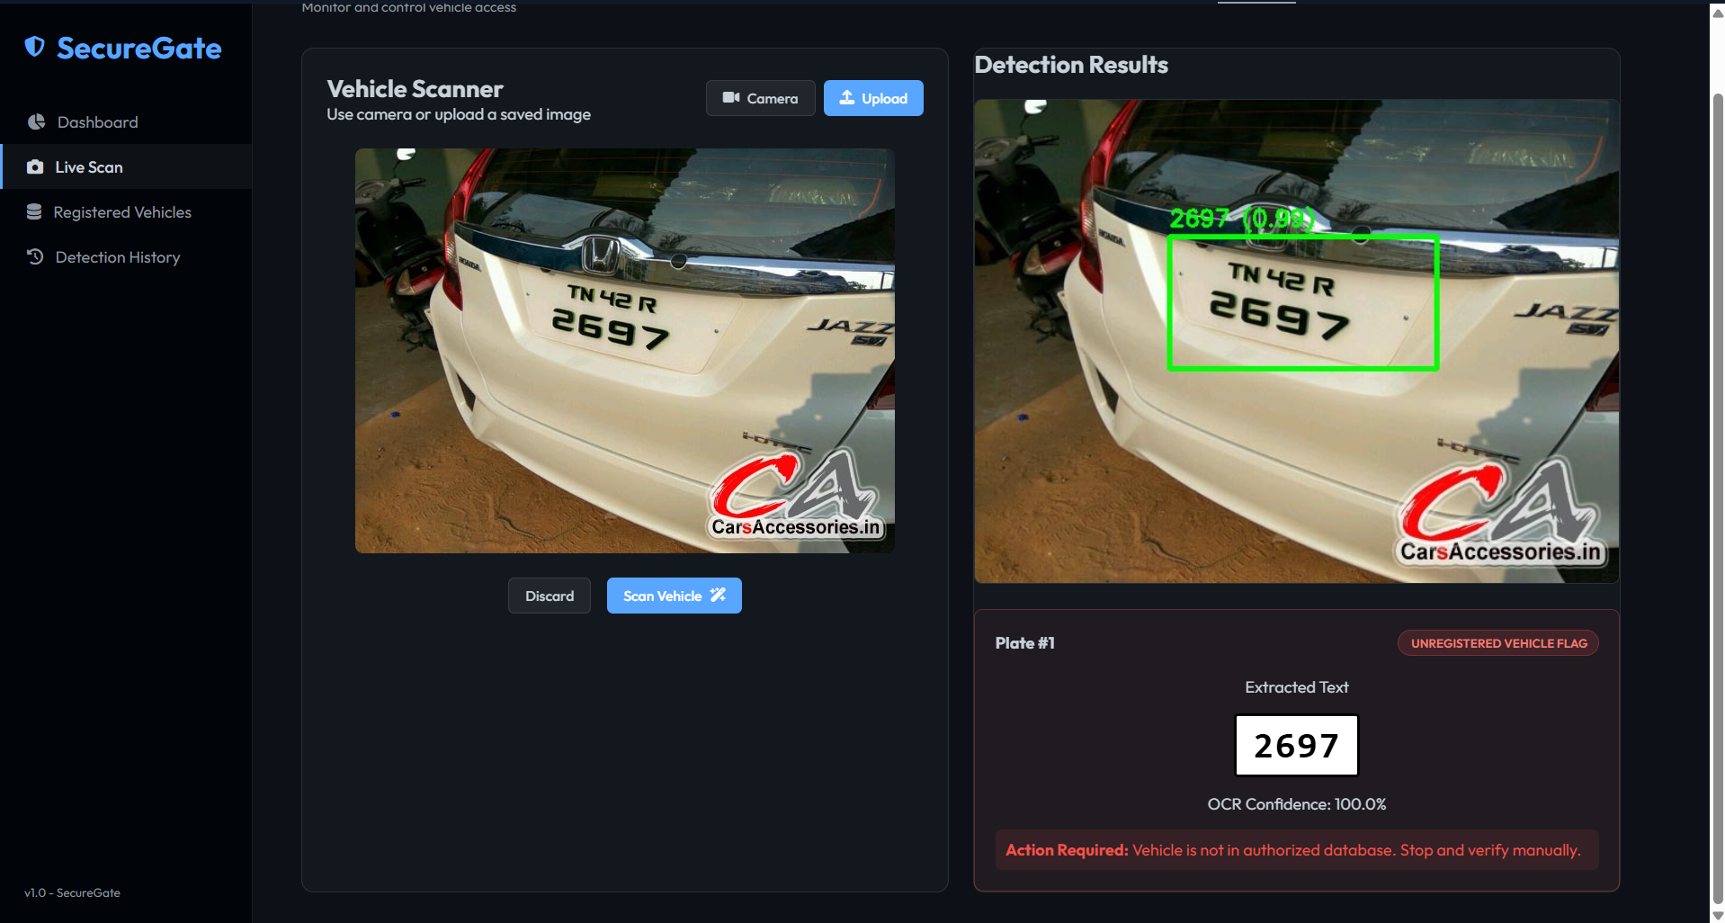
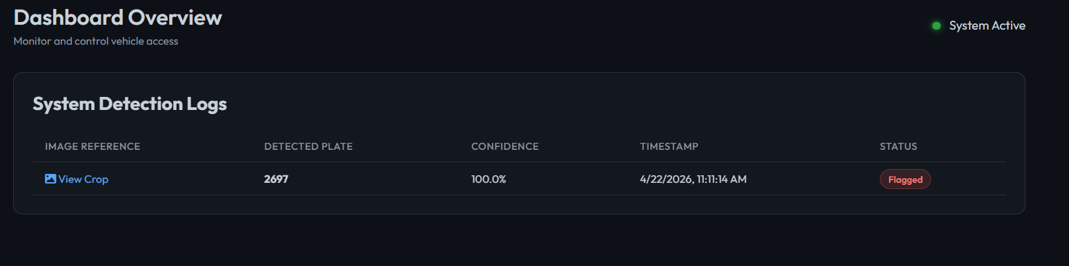
Results & Outputs

Slide 8
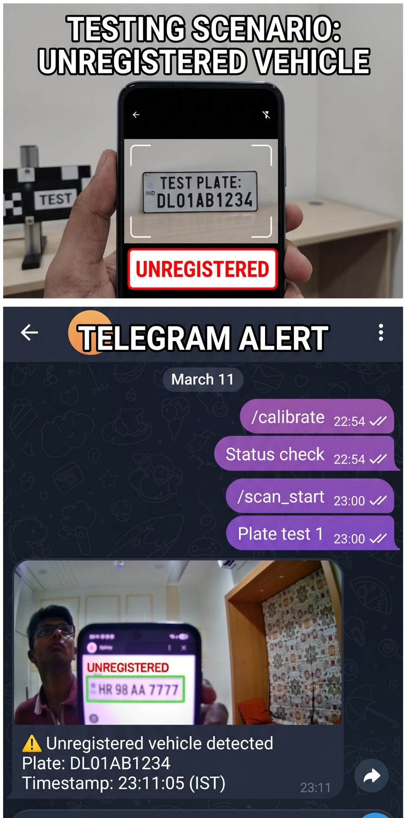
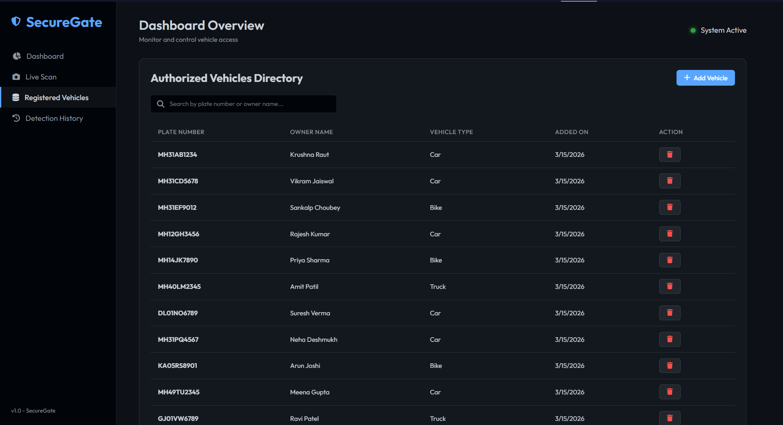
Results & Outputs
Registered Vehicles

Slide 9

Results &
Outputs

Slide 10
Challenges & Learnings
Challenges:
• Poor image quality (blur, low resolution)
• Uneven lighting conditions
• Similar character confusion (0/O, 1/I)
• Lack of labeled dataset
Learnings:
• Preprocessing is critical for OCR performance
• YOLOv8 provides efficient real-time detection
• Thresholding techniques impact accuracy significantly
• Data quality matters more than model complexity
Notes:
TikTok has the highest engagement.
Short-form content performs best across platforms.
YouTube and Instagram show steady engagement.
Twitter has lower engagement.

Slide 11
Future Work
• Improve OCR accuracy using custom-trained models
• Deploy on edge devices (CCTV systems)
• Add multi-National plate recognition (Currently India based)
• Integrate with real-time surveillance systems
• Expand dataset with labeled annotations

Slide 12
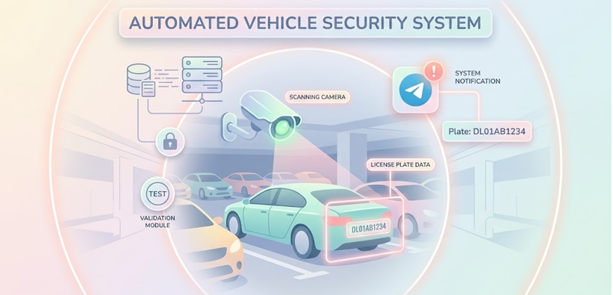
CONCLUSION
• Developed an automated license plate recognition system
• Integrated detection, OCR, and database validation
• Achieved reliable performance in real-time scenarios

Slide 13
THANK YOU!

